Slide 1
Introductory General Chemistry
Chemistry 3A
S. M. Halloran

Slide 2

Math in Chem: Algebra Review
The quantity a
The inverse of the quantity: $\frac{1}{a}=1/a$
The inverse of the inverse takes you back: $\frac{1}{\left(\frac{1}{a}\right)}=a$
$$\frac{\left(\frac{a+b}{c −d}\right)}{\left(\frac{e+f}{g−h}\right)}=\frac{\left(a+b\right)\left(g−h\right)}{\left(c−d\right)\left(e+f\right)}$$
“Implied denominator of 1”. It might help when solving chemistry problems
The number 2.4 = $\frac{2.4}{1}$

Slide 3
Quantities
Number | Unit | Dimension
1 | mile | length (distance)
0.25 | liters | volume
15 | amperes | electric current
A (measured) quantity in science, in chemistry has a number and a unit associated with it
The number is how many/much
The unit is a scale of the measurement, the how many/much of what

Slide 4
Scientific Notation
A way of expressing numerical values
Format: d.mmm × 10^{n}
Part | d.mmm
Part Name | Significand (preferred), Coefficient, (Mantissa is obsolete term)
Part Property | Number greater than or equal to 1.0 and less than 10. This number properly express significant digits
Part | 10^{n}
Part Name | Exponent
Part Property | Exponent of 10 where n is integer, negative, positive (note 10⁰ = 1)

Slide 5

Scientific Notation
decimal point moves to right
1. = 10⁰
10. = 10¹
100. = 10²
decimal point moves to left
0.1 = 10⁻¹ = 1/10 = $\frac{1}{10}$ (expressed in various ways)
0.01 = 10⁻² = 1/100 = $\frac{1}{100}$
0.001 = 10⁻³ = 1/1000 = $\frac{1}{1000}$
1 atmosphere (atm) = 101,325 Pascals (Pa)

Slide 6
Scientific Notation
Is the number less than 10 and greater than 1?
You don’t really need scientific notation, because it will be [ d.mmm × 10⁰ ] and 10⁰ = 1, so → d.mmm
Otherwise take the number and express as d.mmm
If original number is greater than d.mmm you have to multiply by 10¹ n times to get to original number, so n will be positive (greater than zero): n × 1 = n (greater than zero)
If original number less than d.mmm you have to multiply by 10⁻¹ n times to get to original number, so n will be positive (greater than zero): n × -1 = -n (less than zero)

Slide 7
Scientific Notation
Reiterating #3
If original number is greater than d.mmm you have to multiply by 10¹ n times to get to original number, so n will be positive (greater than zero): n × 1 = +n
Your book: “if you moved decimal point to the left n places, then n is positive”
35 → 35. → 3.5 moved to left 1 place
3.5 × 10¹
23849 → 23849. → 2.3849 moved to left 4 places
2.3849 × 10⁴

Slide 8
Scientific Notation
Reiterating #4
If original number less than d.mmm you have to multiply by 10⁻¹ (or divide by 10) n times to get to original number, so n will be negative (less than zero): n × -1 = -n
Your book: “if you moved decimal point to the right n places, then n is negative”
0.0000035 → 3.5 moved to right 6 places
3.5 × 10⁻⁶
0.023849 → 2.3849 moved to right 2 places
2.3849 × 10⁻²

Slide 9
Scientific Notation
Patterns for memorizing
decimal point movement – number being changed – final exponent value
Left – Large – Positive
Right – Small – Negative
Positive and negative for exponent, not significand!
34249 → 3.4249 × 10⁴
-34249 → -3.4249 × 10⁴
0.0034249 → 3.4249 × 10⁻³
-0.0034249 → -3.4249 × 10⁻³

Slide 10
Scientific Notation
Scientific notation is actually a product of two numbers: the significand and a power of 10!
34249 = 3.4249 × 10⁴ = 3.4249 × 10,000 = 34249
-34249 = -3.4249 × 10⁴ = -3.4249 × 10,000 = -34249
0.0034249 = 3.4249 × 10⁻³ = 3.4249 × 0.001 = 0.0034249
-0.0034249 = -3.4249 × 10⁻³ = -3.4249 × 0.001 = -0.0034249
Use this feature to confirm whether you converted a number to scientific notation properly!

Slide 11
Practicing Scientific Notation
Let’s start with an “original” number
one not in scientific notation
This number will be (much) greater than 10
238,700
Two hundred thirty-eight thousand seven hundred

Slide 12
Practicing Scientific Notation
238,700
Our goal will be to get to a number between 1 and 10 since scientific notation requires it, and it should include the leftmost non-zero digit to the rightmost non-zero digit
This span of digits will be the significand
The significand should in the end be of d.mmm… form2.387
So we need to determine the exponent (power of 10)

Slide 13
Practicing Scientific Notation
1. Place the “implied” decimal point where it should be
238,700.
2. Move it in the direction of where it should end up
This is to the left to produce a 2.387 significand
23,870.
3. What is the relationship between 238,700 and 23,870? You have to multiply by 10!
That is 238,700 = 23,870 x 10
We also note that 10 = 10¹
So 238,700 = 23,870 x 10¹
Let’s repeat the movement until we get to proper form

Slide 14
Practicing Scientific Notation
238,700. (the original number)
23,870. → 23,870 x 10¹ = 238,700
2,387. → 2,387 x 10² = 238,700
238.7 → 238.7 x 10³ = 238,700
Note that we were dropping zeroes until we hit the non-zero number “7”, but the decimal point still moves
23.87 → 23.87 x 10⁴ = 238,700
2.387 → 2.387 x 10⁵ = 238,700
The decimal point was not moved to create the significand: we have a number less than 10, greater than 1. With each movement of decimal point, we created the power of 10. At every step, equal to original number

Slide 15
Practicing Scientific Notation
Let’s try a number much less than 1
0.00003049 (the original number)
Following the rules/format, the significand should look like 3.049 in the end
0.0003049 / 10 = 0.00003049
0.0003049 x 10⁻¹ = 0.00003049
0.003049 / 100 = 0.00003049
0.003049 x 10⁻² = 0.00003049
0.03049 / 1000 = 0.00003049
0.03049 x 10⁻³ = 0.00003049
0.3049 / 10000 = 0.00003049
0.3049 x 10⁻⁴ = 0.00003049
3.049 / 100000 = 0.00003049
3.049 x 10⁻⁵ = 0.00003049
2,387. → 2,387 x 10² = 238,700
238.7 → 238.7 x 10³ = 238,700
Note that we were dropping zeroes until we hit the non-zero number “7”, but the decimal point still moves
23.87 → 23.87 x 10⁴ = 238,700
2.387 → 2.387 x 10⁵ = 238,700
The decimal point was not moved to create the significand: we have a number less than 10, greater than 1. With each movement of decimal point, we created the power of 10. At every step, equal to original number

Slide 16
Significant Digits
Significant digits indicate the precision, the confidence of a single measurement
Also called significant figures
Measurement/Value | Significant Digits | Explanation
1.7 | 2 | All non-zero digits significant
1.732 | 4
17.32704 | 7 | Zeroes between non-zero digits are significant

Slide 17
Significant Digits
Measurement/Value | Significant Digits | Explanation
0.0045 | 2 | leading zeroes after decimal point not significant
0.00450 | 3 | trailing zeroes after decimal are significant
1200 | 2
1200. | 4 | assertion of decimal point makes significant
0.000 | 0 | no non-zero digits at all
1000.0 | 5 | adding decimal point and any zeroes after it makes all digits significant
100 | 1 | evaluated like the “1200” example above
1.200 × 10⁻³ | 4 | all digits in scientific notation should be significant

Slide 18
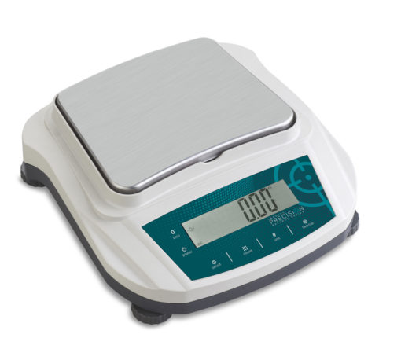
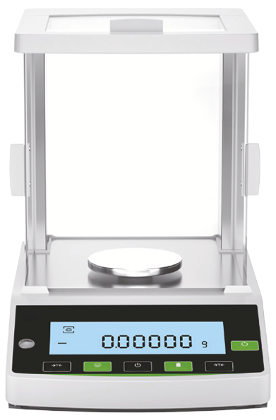
Significant Digits
Significant digits indicate the precision, the confidence of a single measurement
Preparative balance
Measuring quantities usually 0.1 g (100 mg) or greater
used to weigh masses for starting a chemistry experiment
Precision example: 3.4 g sodium chloride (NaCl)
Analytical balance
Measuring quantities usually down to 0.0001 g (0.1 mg or 100 µg) or greater
used to weigh masses for determining yield of product at end of a chemistry experiment
Precision example: 0.0241 g copper(II) sulfate pentahydrate

Slide 19
18 ≠ 18. ≠ 18.0 ≠ 18.00
They are all mathematically equal to 18
But they are not the same in terms of the precision or certainty of the value
18 ➔ 2 significant digits: ±1
18. ➔ also 2 significant digits: ±1
But the measuring device will show decimals
18.0 ➔ 3 significant digits: ±0.1
18.00 ➔ 4 significant digits: ±0.01

Slide 20
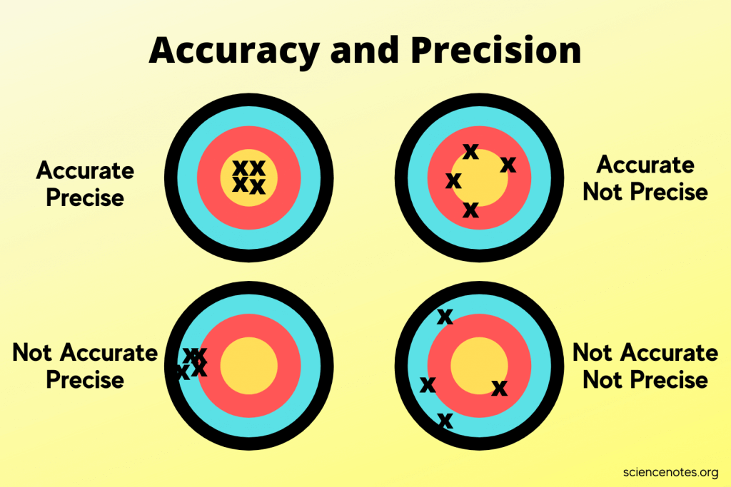
A Slight Tangent on “Precision”
Multiple Measurements
Precision – an indicator of how measurements repeat the value being measured
Accuracy – an indicator of how measurements get to the true value

Slide 21
Significant Digits in Scientific Notation
The rules on significant digits in numerical values always apply in scientific notation
2.69 × 10⁻⁵ = 0.0000269 (3 significant digits)
2.69000 × 10⁻⁵ = 0.0000269000 (6 significant digits)
2.69 × 10³ = 2690 (3 significant digits)
You still have add the zero to get standard form of number as integer
2.69000 × 10³ = 2690.00 (6 significant digits)

Slide 22
Doing Math with “Decimal Places”
Addition and Subtraction of Numbers with Different Decimal Places
Decimal places for final answer should be the one number with the fewest number of decimal places
Solve 12.11 + 18.0 + 1.013 =
Solve 100.29 – 2.343 – 72.9 =
Solve 1000.23 – 87.532 + 200.49 – 50.439 =
 |  |  |  | Result
 |  |  |  | Calculator's Display | Your Answer
Value | 12.11 | 18.0 | 1.013 | 31.123 | 31.1
Decimal Places | 2 | 1 | 3 | 3 | 1
 |  |  |  | Result
 |  |  |  | Calculator's Display | Your Answer
Value | 100.29 | 2.343 | 72.9 | 25.047 | 25.0
Decimal Places | 2 | 3 | 1 | 3 | 1
 |  |  |  |  | Result
 |  |  |  |  | Calculator's Display | Your Answer
Value | 1000.23 | 87.532 | 200.49 | 50.439 | 1062.749 | 1062.75
Decimal Places | 2 | 3 | 2 | 3 | 3 | 2

Slide 23
Doing Math with Sig Digits
Multiplication and Division of Numbers with Different Significant Digits
Significant digits for final answer should be the one number with the fewest number of significant digits
Solve 4.56 x 1.4 =
Solve 834.4 ÷ 34.92 x 2.104 =
Solve 2340.09 ÷ 24.190 =
 |  |  | Result
 |  |  | Calculator's Display | Your Answer
Value | 4.56 | 1.4 | 6.384 | 6.4
Sig Digits | 3 | 2 | - | 2
 |  |  |  | Result
 |  |  |  | Calculator's Display | Your Answer
Value | 834.4 | 34.92 | 2.104 | 50.27427262 | 50.27
Sig Digits | 4 | 4 | 4 | - | 4
 |  |  | Result
 |  |  | Calculator's Display | Your Answer
Value | 2340.09 | 24.190 | 50.27427262 | 50.27
Sig Digits | 6 | 5 | - | 4

Slide 24
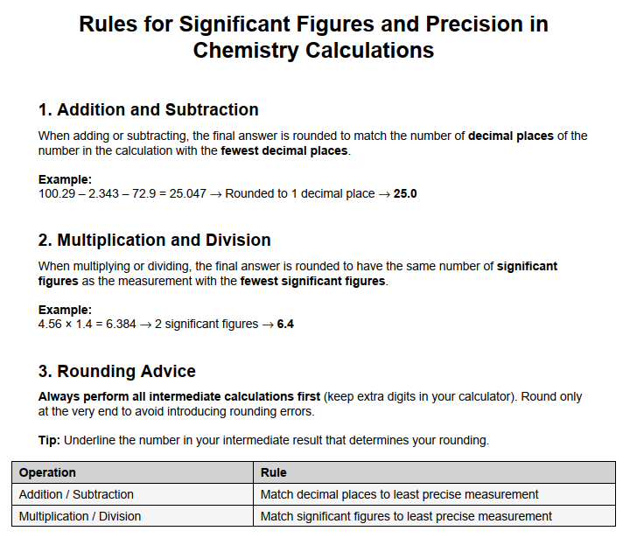
This sheet (also as a PDF in Canvas LMS app) was produced by ChatGPT3.5

Slide 25
Doing Calculations: NO INTERMEDIATE ROUNDING!!!
Simple example
Calculate the cost of carpeting a 4.8 m x 3.2 m floor where the carpeting costs $42 per square meter
Suppose you do the calculation in steps (intermediate calculations):
The area: 4.8 m × 3.2 m = 15.36 m² (value on calculator display)
Finishing off
rounding no decimal: 15 m² × ($42 / m²) = $630.00
rounding to one decimal: 15.4 m² × ($42 / m²) = $646.80
no rounding: 15.36 m² × ($42 / m²) = $645.12
No need for intermediate result determination in (nearly) all cases:
4.8 m × 3.2 m × ($42 / m²) = $645.12
In business accounting & chemistry, do the rounding at the end of the calculation. To significant digits (or decimal places)

Slide 26
Doing Chem Math
Addition and Subtraction
look at the DECIMAL PLACES!
Multiplication and Division
look at the SIGNIFICANT DIGITS!
The Book
Do the Multiplication and Division first
Then do Addition and Subtraction operations
If you do intermediate rounding—I wouldn’t!—then if you follow the book, this is acceptable

Slide 27
PEMDAS
PEMDAS -- (P)arentheses, (E)xponents, (MD) Multiplication/Division, (AS) Addition/Subtraction
5 + 6 x 2 - 8 / 4
P and E: none
MD: 5 + 12 - 2
AS: 15
14² + 633 / 3 - 14 x 8
P: none
E: 196 + 633 / 3 - 14 x 8 (did 14²)
MD: 196 + 211 - 112
AS: 295

Slide 28
PEMDAS
PEMDAS -- (P)arentheses, (E)xponents, (MD) Multiplication/Division, (AS) Addition/Subtraction
(22.17 + 100.24) x (443.4 + 349.3) / 4³
P: 122.41 x 792.7 / 4³
E: 122.41 x 792.7 / 64 (64 is not a MEASUREMENT!)
MD: 1516.162609
AS: 1516.162609 ==> 1516

Slide 29
PEMDAS
PEMDAS -- (P)arentheses, (E)xponents, (MD) Multiplication/Division, (AS) Addition/Subtraction
100.13 – 23.433 / ((443.4 + 349.3) / 2⁴)
P: 100.13 – 23.433 / (792.7 / 2⁴) → 100.13 – 23.433 / (792.7 / 16) → 100.13 – 23.433 / 49.54375
E: evaluated within parentheses!
MD: 100.13 - 0.47297590513
AS: 99.6570240949 ==> 99.66

Slide 30
Conversion Factors
Calculations in chemistry frequently require converting between the units of a quantity
Volume: fluid ounces to milliliter (“fl oz” to “ml”)
Temperature: Celsius to Kelvin (“°C” to “K”)
Pressure: torr to atmosphere (“torr” to “atm”
Conversions not just about measurement systems but also include scales which are powers of 10
1 liter (L) = 1000 milliliters = 1000 mL
not 1000 ml! use SI unit lettering case
1 kilogram (kg) = 1000 grams (g)

Slide 31
Conversion Nomenclature
Prefix | Meaning | Example
Multiple of 10 (greater than 1)
kilo- (k) | 10³ = 1000 | 2 kilograms (kg) = 2000 grams
mega- (M) | 10⁶ = 1,000,000 | 3.7 megajoules (MJ) = 3,700,000 J
giga- (G) | 10⁹ = 1,000,000,000 | 10 gigahertz (GHz) = 10,000,000,000 Hz
Submultiples of 10 (fractions of 1)
deci- (d) | 10⁻¹ = 1/10 | 1 deciliter (dL, dl) = 0.1 L
centi- (c) | 10⁻² = 1/100 | 2.54 centimeter (cm) = 0.0254 m
milli- (m) | 10⁻³ = 1/1000 | 14 millibar (mbar) = 0.014 bar
micro- (u/µ) | 10⁻⁶ = 1/1000000 | 259 microliters (µl, ul, µL, uL) = 0.000259 L
nano- (n) | 10⁻⁹ = 1/1000000000 | 34 nanograms (ng) = 0.000000034 g
pico- (p) | 10⁻¹² = 1/100000000000 | 250 picoliters (pL) = 0.00000000025 L
femto- (f) | 10⁻¹⁵ =1/ 1000000000000000 | 4.3 femtomoles (fmol) = 0.0000000000000043 mol
units in green are often used in chemistry

Slide 32
Conversion Practice
A room measures 16 ft x 20 ft in area. What is it in square meters (m²)
A conversion problem is going to be an equation usually involving a mathematical product (the multiplication of quantities), and these quantities will include your given quantities and conversion factors
16 ft × 12 ft × ….. = ? m²

Slide 33
Conversion Practice
A room measures 16 ft x 20 ft in area. What is it in square meters (m²)
I remember
12 inches = 1 foot
2.54 cm = 1 inch
100 cm = 1 meter
These are actually conversion factors !
We have to get enough conversion factors to go from units on the left to the result with unit on right of equation!
16 ft × 12 ft × ….. = ? m²

Slide 34
Conversion Practice
A room measures 16 ft x 20 ft in area. What is it in square meters (m²)
12 inches = 1 foot
2.54 cm = 1 inch
100 cm = 1 meter
We know we have to multiply 16 ft x 12 ft to get an area ➔ that will give us a value in square feet (ft²)
16 ft × 12 ft × ….. = ? m²

Slide 35

Conversion Practice
A room measures 16 ft x 20 ft in area. What is it in square meters (m²)
12 inches = 1 foot
2.54 cm = 1 inch
100 cm = 1 meter
So we need a conversion factor that is in ft²
12 in = 1 ft ➔ (12 in)² = (1 ft)²
I am not going to evaluate it right now: I will add it to the equation
$$\frac{16 \text{ft}}{1}×\frac{12 \text{ft}}{1}×\frac{{(12 \text{in})}^{2}}{{(1 \text{ft})}^{2}} × …= ? \text{m}2$$

Slide 36

Conversion Practice
$$\frac{16 \text{ft}}{1}×\frac{12 \text{ft}}{1}×\frac{{(12 \text{in})}^{2}}{{(1 \text{ft})}^{2}} × …= ? \text{m}2$$
I added the conversion factor in a way that when “ft x ft” is evaluated, it equals “ft²”
If we evaluate that expression right now and stop, we drop the units to get just the numbers, and we get an answer of 16 x 12 x 12² = 27468
The ft x ft / ft² should “cancel”: two “ft” in the numerator, “ft²” in the denominator “in²” is left in the numerator, so that would be the intermediate result: “27,468 in²”

Slide 37

Conversion Practice
$$\frac{16 \text{ft}}{1}×\frac{12 \text{ft}}{1}×\frac{{(12 \text{in})}^{2}}{{(1 \text{ft})}^{2}} ×\frac{{(2.54 \text{cm}\text{)}}^{2}}{{(1 \text{in})}^{2}}×\frac{{(1 \text{m}\text{)}}^{2}}{{(100 \text{cm})}^{2}}= ? \text{m}2$$
Note that we had to use the squared version of these linear conversions to get cancellation of the units in the quantities, but this is to demonstrate what you may sometimes need to keep track of. The book discusses this too.
When you have ensured all the units cancel, remove them from the equation, and evaluate the expression on the left
$$\frac{16}{1}×\frac{12}{1}×\frac{{(12)}^{2}}{{(1)}^{2}} ×\frac{{(2.54\text{)}}^{2}}{{(1)}^{2}}×\frac{1^{2}}{{100}^{2}}=17. 8 \text{m}2$$

Slide 38

Conversion Practice
Now I suppose you could look up in a table that 1 ft² = 0.092903 m²
$$\frac{16 \text{ft}}{1}×\frac{12 \text{ft}}{1}×\frac{{0.092903 \text{m}}^{2}}{{1 \text{ft}}^{2}} =17.8 \text{m}2$$
Just keep in mind what the conversion factor is and how you use it to cancel units properly in evaluating the product. Ensure that the resulting final unit is what it should be.

Slide 39

Density
How much mass is in a given volume
The math definition:
Greek letter rho (ρ) is symbol for density
$$density= \frac{mass}{volume}$$
$$ρ=\frac{m}{V}$$

Slide 40
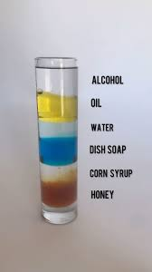
Densities of Natural Substances
Table 1.4.1: Densities of Common Substances
Substance | Density at 25°C (g/cm3)
blood | 1.035
body fat | 0.918
whole milk | 1.030
corn oil | 0.922
mayonnaise | 0.910
honey | 1.420

Slide 41
Problem Solving Process Using Density
The problem/question (from your book)
A mercury thermometer for measuring a patient’s temperature contains 0.750 g of mercury.
What is the volume of this mass of mercury?
The most important thing you will ever do is to spend the time and effort to fully understand the question, and identify the key elements of it
Look for what is asked for: volume of mercury
Look for what is given: a mass (7.50 g) of mercury

Slide 42
Problem Solving Process Using Density
What is missing from the information given in the problem/question?
Usually the information not given are constants of nature and (numerical) properties of matter and energy like atomic weights. In this case, it is a density.
The density of a substance is a property that allows you to relate its mass to its volume and vice versa
The density of water is 1 g/mL (at 0°C) and is a property of water
The density of mercury is 13.6 g/mL

Slide 43

Problem Solving Process Using Density
For this equation about density, this is all just algebra below which you already know
$ρ=\frac{m}{V}$ ➔ $V×ρ=m$ ➔ $V=\frac{m}{ρ}$ $=$ $\frac{1}{ρ}$ $×m$
In the last manipulation, we have an expression that tells us what the volume is equal to: the inverse of the density multiplied by the mass, or “mass over density”

Slide 44

Problem Solving Process Using Density
$\frac{1}{ρ}$ $×m=V$
We now just enter the values to solve:
$$\frac{1}{13.6 \text{g}\text{ /}\text{mL}}×7.50 \text{g}=\frac{1 \text{mL}}{13.6 \text{g}}×7.50 \text{g}=0.55 \text{mL}$$
Could be expressed as 5.5 x 10⁻¹ mL
Or converting to microliters (µL)
$$0.55 \text{mL}×\frac{1000 \text{µ}\text{l}}{1 \text{mL}}=550 \text{µ}\text{L}$$

Slide 45
Temperature
A measure of the average kinetic energy of particles in a substance
Not energy itself, but an indicator or measure of energy

Slide 46
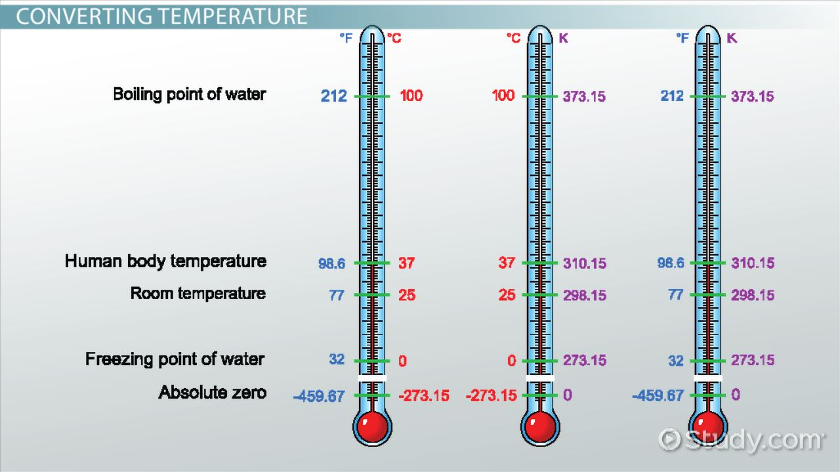
Measuring Temperature
image from Study.com

Slide 47
Temperature Scales
Three scales (measurement types) are used to get a value of temperature
Thermometers usually involve expansion or contraction of calibrated sealed tube of mercury (Hg) or dyed-alcohol
Scale | Water Property
 | freezing point | boiling point
Fahrenheit | 32° F | 212° F
Celsius (centigrade) | 0° C | 100° C
Kelvin | 273 K | 373 K

Slide 48




Converting Temperature
Conversions apply basic algebraic principles of sloped lines
s$\text{lope} =\frac{373 −273}{100 − 0}$ = 1
$$°C =K −273$$
2$73 =1 ×0+\text{intercept}$
Intercept = 273
K$=°C+273$

Slide 49


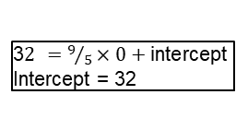

Converting Temperature
Fahrenheit not used in chemistry, but be prepared to convert
s$\text{lope} =\frac{212 −32}{100 − 0}=\frac{180}{100}=\frac{9}{5}$
$$°C =\frac{5}{9}\left(°F −32\right)$$
3$2 =9/5×0+\text{intercept}$
Intercept = 32
°$F =\frac{9}{5}°C+32$

